Slide 1

Cracking the Machine Learning Code: A Deep Dive into the ML Workflow
Developed by: Kyle Kinsella | C00273146 Date: April 4th 2025 Course: Bachelor of Science (Honours) in Software Development Lecturer: Greg Doyle

Slide 2
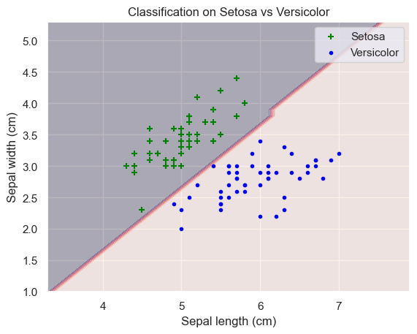
Introduction
Good morning, today I’ll be demonstrating my Data Science & Machine Learning Portfolio, showcasing the models I’ve developed and the process I used to create them.
Here are the topics I’ll be covering today:
The approach I took in developing these models
A description of each model
Opportunities & Challenges faced during each project
A live demo
Conclusion
Naïve Bayes

Slide 3

The process I followed in developing these models
During the development of each of my machine learning projects I followed the Crisp-Dm (Cross-Industry Standard Process for Data Mining) process model, I chose to use this process model because it gave me a structured and iterative approach for each of my models.
The Crisp-Dm process model has the following headings:
Business Understanding
Data Understanding
Data Preparation
Modelling
Evaluation
Deployment
Naïve Bayes

Slide 4
Description
Naïve Bayes:
Build a model to classify text as spam or ham. The dataset had about 5,000 rows.
Support Vector Machines (SVM):
Developed a model to discriminate between two classes of data using the load iris dataset.
Convolutional Neural Network (CNN):
Trained a model to recognize different types of fruits. The dataset had 22,495 images of fruits.
Recurrent Neural Network (RNN):
Built a model to classify handwritten numbers. The dataset had about 70,000 images.
Naïve Bayes

Slide 5
Opportunities & Challenges
Implications | Naïve Bayes | Support Vector Machines | Convolutional Neural Network | Recurrent Neural Network
Opportunities | Text Classification Very good for Spam Detection | Easy to understand Discrimination Classification | Effective for image classification Important features | Sequential data Effective for messaging services and language conversion
Challenges | Minimal problems | Visualization | Compute Power Expensive Hard to understand | Compute Power Expensive Hard to understand

Slide 6
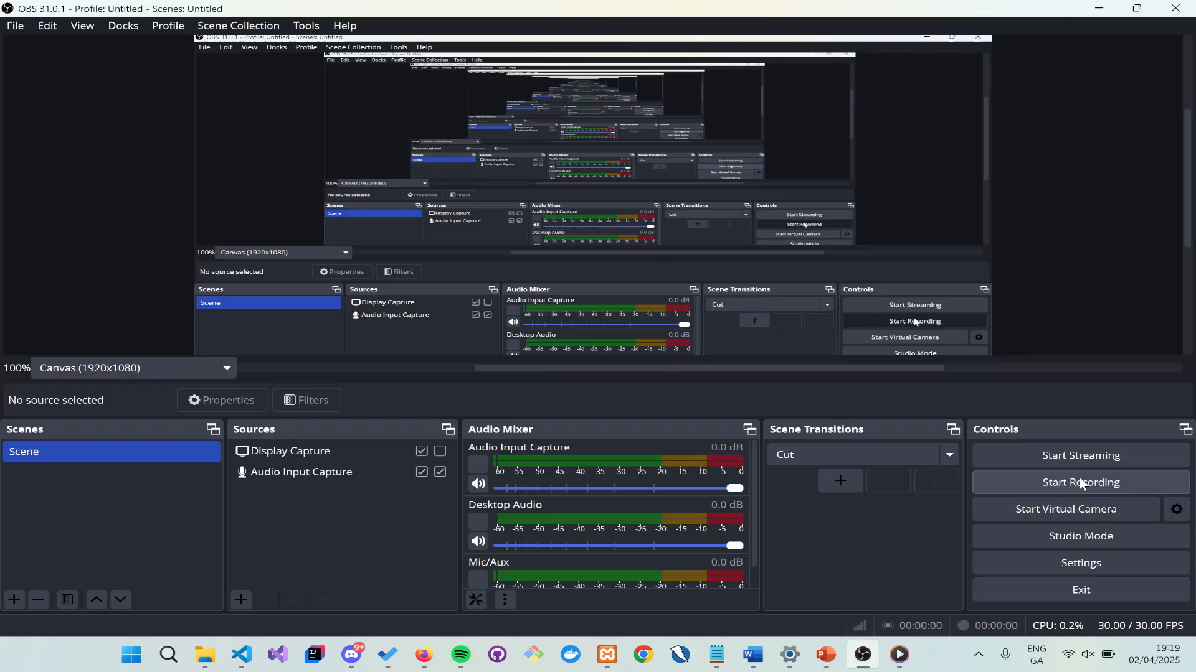
Demonstration: Naïve Bayes

Slide 7
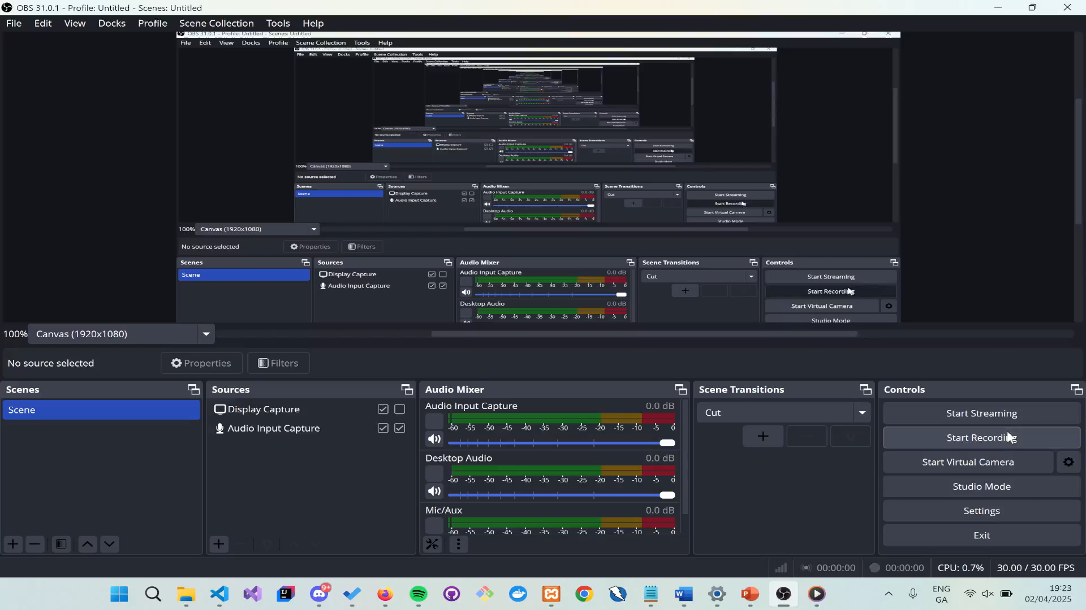
Demonstration: Support Vector Machines

Slide 8
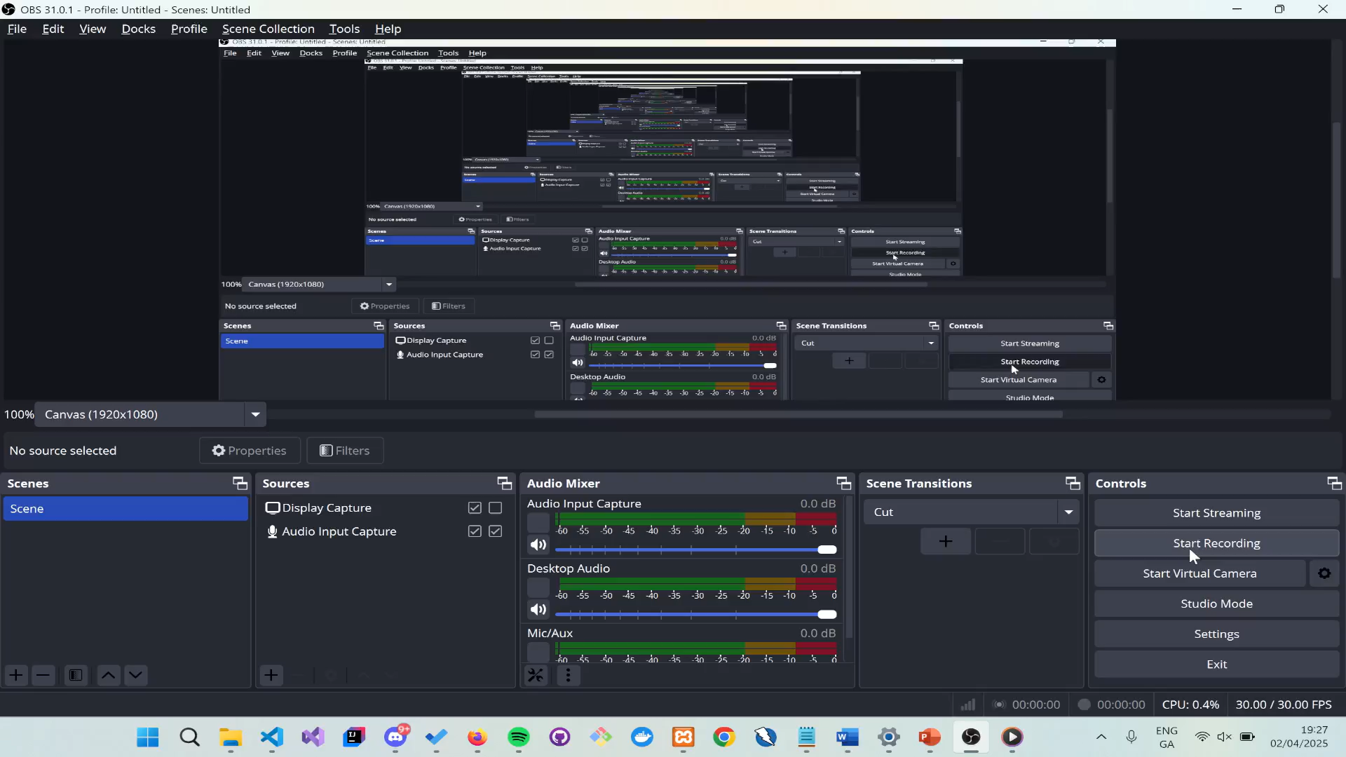
Demonstration: Convolutional Neural Network

Slide 9
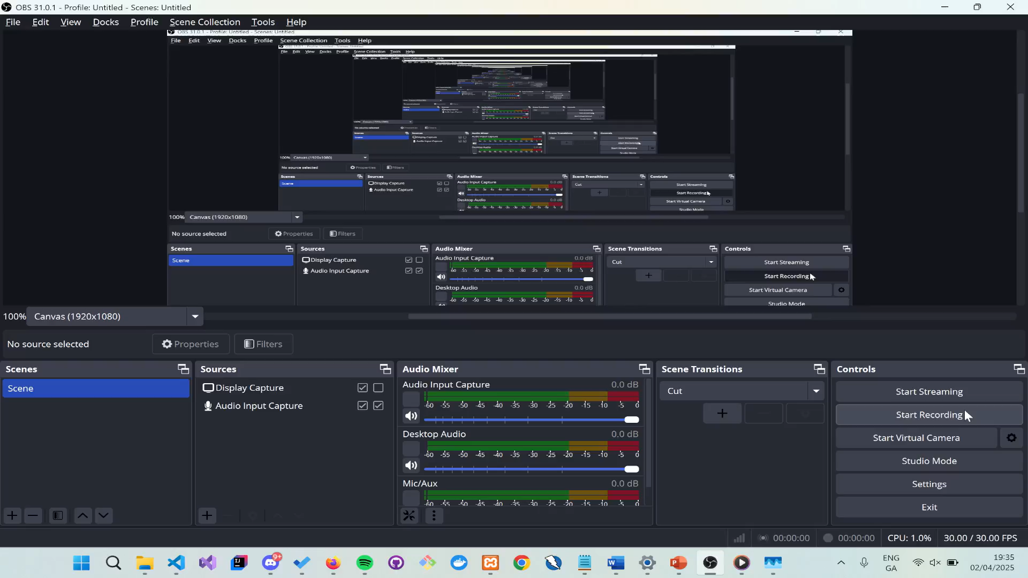
Demonstration: Recurrent Neural Network

Slide 10
Conclusion
To conclude my Data Science & Machine Learning Portfolio, I have explored various machine learning models, and each demonstrate their unique strengths and the applications in the real world.
If you want create a project for text classification, use a naïve baye model.
If you want to discriminate between two classes, use a support vector machine model.
If you want to do image processing, use a convolutional neural network.
If you want to predict the next word in a sentence, use a recurrent neural network.

Slide 11


Acknowledgements
Additionally, I would like to extend my sincere thanks to Greg Doyle for all the insightful lectures. I have truly enjoyed this module, and I hope that in the future, I can apply some of the machine learning models that I have created for my portfolio in real-word projects.

Slide 12

Thank you very much for taking the time to listen to my presentation on my Data Science & Machine Learning Portfolio!

Slide 13
References
Wikipedia. (2022). South East Technological University. [online] Available at: https://en.wikipedia.org/wiki/South_East_Technological_University.
with (2025). Thank You Digital Images – Browse 53,198 Stock Photos, Vectors, and Video. [online] Adobe Stock. Available at: https://stock.adobe.com/ie/search?k=thank+you+digital [Accessed 30 Mar. 2025].
Dreamstime (2019). Stock Photos And Royalty-Free Images By Dreamstime. [online] Dreamstime.com. Available at: https://www.dreamstime.com/.
Wikipedia Contributors (2019). Cross-industry standard process for data mining. [online] Wikipedia. Available at: https://en.wikipedia.org/wiki/Cross-industry_standard_process_for_data_mining.
‌

